Slide 1
RxJS
Caching Observables
Lecture 9
By James(Jin) Wang
12/05/2021

Slide 2
Outline
Caching Observables
Patterns for data caching

Slide 3
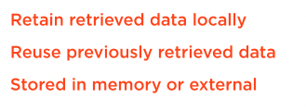
Caching Observables
  Caching Observables

Slide 4
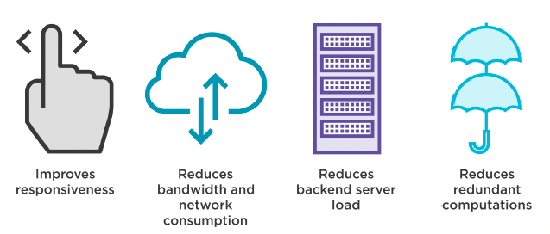
Caching Observables
  Advantage of Caching Data

Slide 5
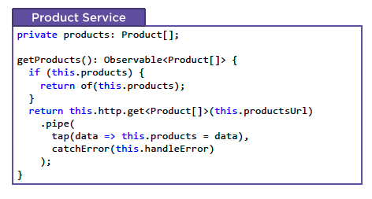
Patterns for data caching
  Classic Caching Pattern

Slide 6
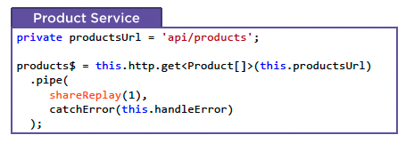
Patterns for data caching
  Declarative Caching Pattern

Slide 7
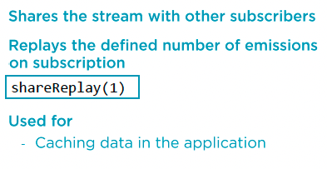
Patterns for data caching
  RxJS Operator: shareReplay

Slide 8
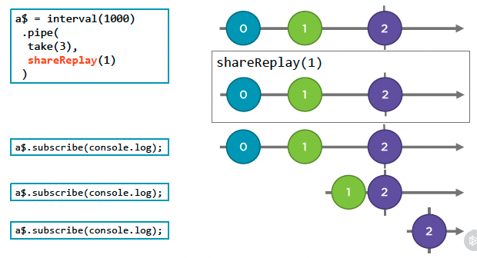
Patterns for data caching
  Marble Diagram: shareReplay

Slide 9
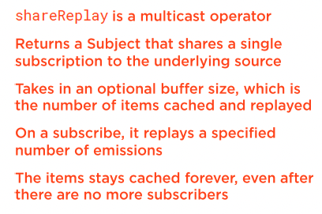
Patterns for data caching
  RxJS Operator: shareReplay
  Demo: cache data with shareReplay

Slide 10
React to selections
  React to selections: Action Stream
  Demo: react to selections Action Stream

Slide 11
React to errors
  React to errors
  Demo: react to errors

Slide 12
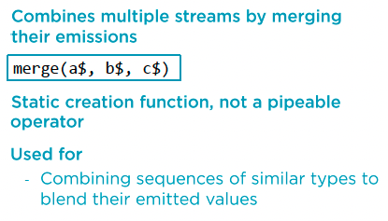
React to add operations
  RxJS Creation Function: merge

Slide 13
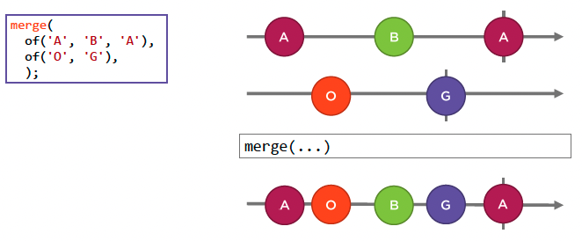
React to add operations
  Marble Diagram: merge

Slide 14
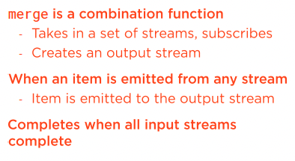
React to add operations
  RxJS Creation Function: merge

Slide 15
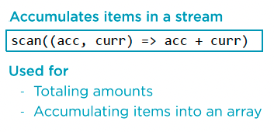
React to add operations
  RxJS Operator: scan

Slide 16
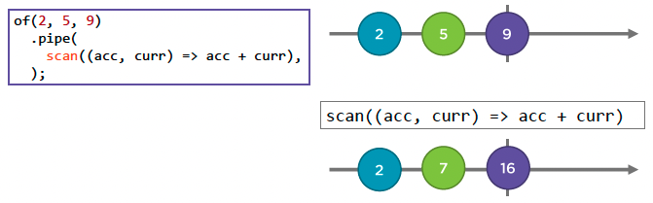
React to add operations
  Marble Diagram: scan

Slide 17
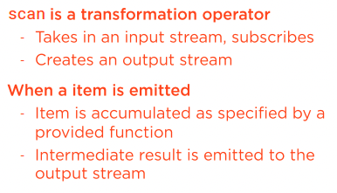
React to add operations
  RxJS Operator: scan

Slide 18
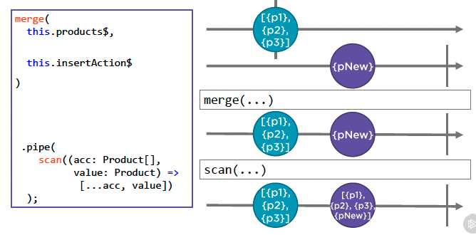
React to add operations
  Reacting to an Add Operation
  Demo: react to add operation

Slide 19
Summary

Slide 20
Assignment

Slide 21
Self Study
  RxJS: The Big Picture
  https://app.pluralsight.com/library/courses/rxjs-big-picture

